Slide 1

US Housing Prices Machine Learning Model
Team Outliers

Slide 2




Team Outliers
Matt Hardy
Ruchi Mathur
Kathy Nwe
Paula Thompson
Notes:
Hi Everyone
My name is Paula Thompson and I will be introducing Team Outliers
Made up of Matt, Ruchi, Kathy and myself

Slide 3
Project Focus
Create a machine learning model to predict housing prices across various regions based on inflation rates, unemployment rates, gas prices, interest rates and average mortgages
40-year high in inflation rates
Interested in understanding the impact these aggressive increases will have on housing prices across our various locations.
Can we predict housing prices based on the above variables across different regions in the United States?
Question
Notes:
Our project was focused on creating a machine learning model that predicts housing prices in the United States based on a number of variables including inflation rates, unemployment, rates, gas prices, interest rates and mortgages

Slide 4
Technologies, Languages, Tools, Etc.
Data Preprocessing
Database
Machine Learning
Dashboard
Python
Pandas
Uszipcode
Geopy
Nominatim API
Pathlib/Path
Jupyter Notebook
SQL
PostgreSQL
Excel
Python
pandas
numpy
matplotlib
sci-kit learn
Seaborn
tensorflow
Jupyter Notebook
Tableau
VizQL
Tkinter (Python)
Notes:
The team used a variety of technologies, languages and libraries during the different stages of our project and you can see a comprehensive list of them here
As we walk through the project you will hear more detail on how some of these tools were used

Slide 5
Data Exploration
Zillow Housing Price Dataset
Consumer Price Dataset
Gas Prices
Mortgage Payment Data
Unemployment Rates
Interest Rates
Notes:
We also pulled data from a variety of sources, including Kaggle as well as a number of government data sources, which we ultimately consolidated into our primary dataset
With that I will hand it off to Matt to talk more about data transformation and pre-processing.

Slide 6
Data Transformation and Preprocessing
Pandas and Excel were used for data preprocessing
The preprocessing steps taken include:
Dropping Null Values
Limiting the date based on availability across various data sources
Transposed data
Set date as index, region id as column headers
Converted date to uniform date-time
Assigned zips and coordinates to locations
Notes:
Hello everyone, I'm Matt Hardy, and I'll be talking about the data tranformation process our team used to make our data useful
for our machine learning model, as well as the Geocoding API we used in order to visualize the data on a map.
screenshot of original dataset:
This is our original dataset of housing prices from different areas over the years, which we obtained form Zillow. It covers
3,728 cities within the US, and ranges from early 2008 all the way to the current month.
Right away you can see there's some null values here. That's because while all the rows contain SOME data, not all the data begins
in 2008. We had to shorten our range of years to being in 2001 because if we elimanated all rows with null values from the
original, unchanged dataset, we were left with only around 500 cities. Our new range allowed us to used almost 1100.
notebook 1, transposed framework:
The next problem we faced was the way our data was shaped. The original dataset was using unique "Region ID's" as an index, the
first few columns to show a city and state, and then more than a hundred columns representing dates. Each of our other data sets
used the date as the index, and so we needed to transpose the data so that each city's Region ID was a column header. In our
early data cleaning, we built a framework for how the data would be transposed once it had gone through the geocoding engine.
notebook 2, duplicates cell:
The region ID was used rather than the city name, because some quick coding revealed that we had more than 100 cities with
identically named counterparts in other states.
notebook 2, zipcodes engine:
Our next issue was that apart from city and state name, no specific geographic information was included in our dataset to facilitate
visualization of the data on a map. After much experimenting, we decided to use the USZIPCODE python library to pair each location
with a zipcode. Many (in fact, most) locations returned more than one zipcode, so we instructed our code to only keep the first
zipcode returned. The library was unable to locate some locations, and so after we processed the zip codes (and eventually
coordinates) we would use python merges to act as SQL inner joins to keep only the locations for which we had complete data.
We also added the cities for which location data couldn't be found to a separate dictionary/dataframe so that we could see exactly
how much data we were purging from our dataset. We later noticed some duplicate zipcodes in our final dataset (it seems that some
suburbs share zip codes without sharing names), and so the code was refactored to exclude duplicates before being pushed back through
the geocoding engine.
notebook 3, geocoding:
once we had our list of cities matched with zipcodes, we used the GeoPy python library to launch an API call to Nominatim, a
geocoding service. Once again,
our engine didn't find results for every last location, and so our dataset was again slightly reduced.
ERD Diagram:
Our cleaned, non-transposed dataset was fed into a PostgreSQL database alongside our various other datasets and our newly populated
geolocation dictionary. Though we could have joined the data into our final dataset using SQL inner joins, we decided to use
python exclusively to do this since it would make the transposition process a bit faster and easier.
notebook 5:
The first thing we needed to do before transposing our data was to purge all locations from our original dataset that didn't appear
in our locations database, which ultimately brought us from 1097 cities down to around 938. This number might change each time
the etl scripts are run, since the API call may locate more or fewer coordinates each time. Once the data had been tranposed,
with the Zip Codes (rather than region ID's) as column headers, each of our other datasets (inflation, mortgage rates, unemployment
rates, interest rates, and gas price data) were loaded, cleaned, and then merged as an inner join to the main dataframe. In most
cases, the only cleaning that needed to take place was to change the date (the index for each source) to a uniform date-time format.
At this point, the data was ready to be used in our machine learning model, but we ran into trouble visualizing it in tableau because
of its extremely wide shape. In the end, we used the Pandas ".melt()" method to create a looooooooong skinny form of our dataset
which was only 8 columns wide, but 104,118 rows long. This version of the data was finally something we could use with tableau.
extracted:
Our first dataset, obtained from Zillow, contained chronologically formatted housing price data from 3,728 cities in the US,
spanning a timeframe between early 2008 all the way to the current month. We initially had thought that pairing this massive data
source with our second dataset, a record of the national Consumer Price Index (all the way back to 1913) would be enough to produce
our model, but as our project evolved we decided to incorporate other datasets that we felt could improve the accuracy of our
algorithm.
Very quickly we realized that there was a problem with our dataset. As you can see in this screenshot, there are many empty cells
in some of these rows. That's because while each row does contain SOME data, the data for each location didn't necessarily begin
in 2008. The first time I tasked Pandas with dropping all rows that contained null values, we lost all but around 500 cities,
hemorraging some of the largest cities in the process. We decided to narrow the scope of the time-frame in our datasource, and
after playing around with a few different starting years, we landed on 2011 because at that point dropping all null values still
left us with almost 1100 cities, which we felt was enough data points to proceed.

Slide 7
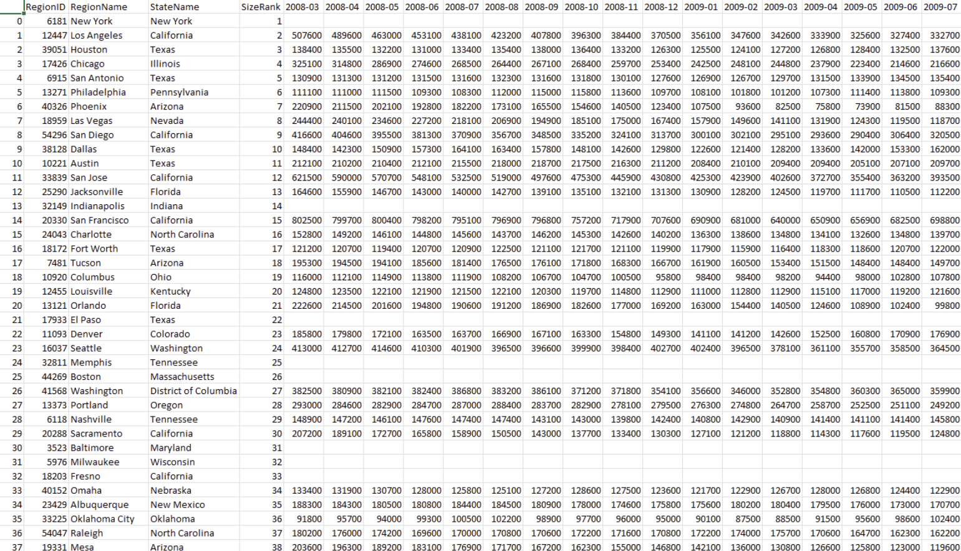
Data Transformation and Preprocessing
Notes:
Matt to share screen after this slide

Slide 8
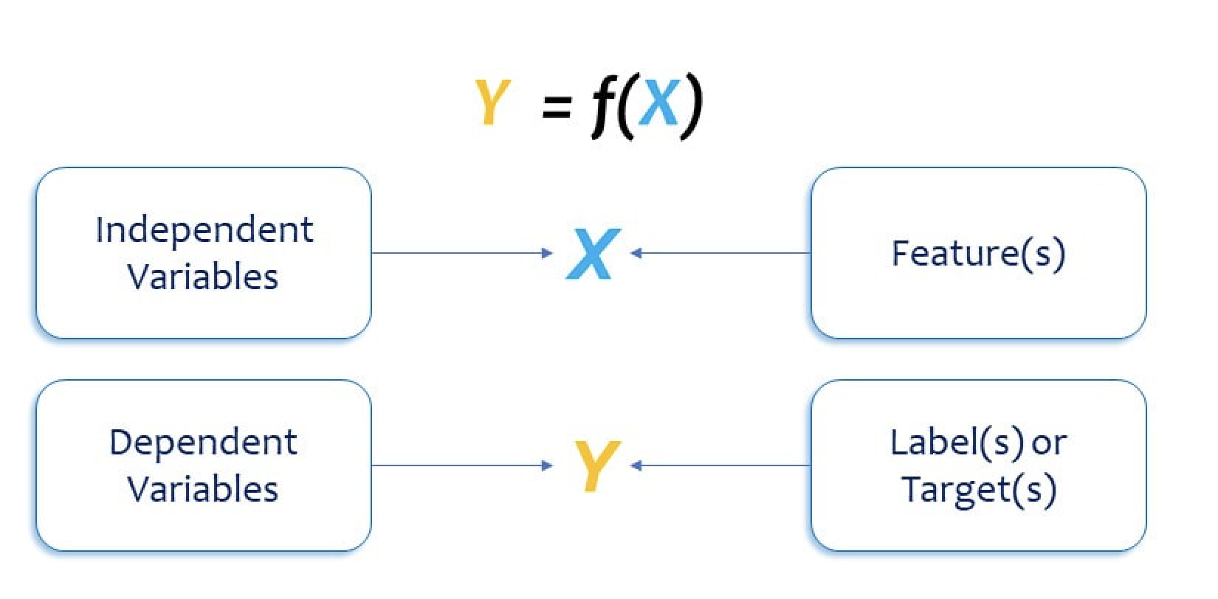
Machine Learning Models
Tested three machine learning (ML) models:
Multiple Linear Regression (model of choice)
Random Forest Regressor
Neural Network Model
Dependent variable
Housing Prices
Independent variables
Gas Prices
Unemployment Rate
Average Mortgage Rate
Interest Rate
CPI (Inflation Indicator)
Notes:
Hello everyone, I am Ruchi please allow me a moment to share my screen.
I will be talking about our machine learning model which will help us predict the housing prices based on various economic factors across different regions in the United States.
We tried few different models and picked the one which was best fit for our problem
In our dataset, housing prices is the target variable.

Slide 9
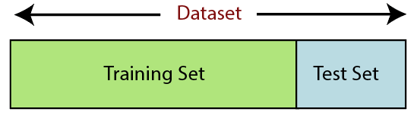
ML: Data Preprocessing
Import dependencies
Import dataset
Check for any missing values
No encoding needed
Split the data into testing and training sets
Feature Scaling
Notes:
In addition to the data transformation done before, we followed additional pre-processing steps prior to initiating the machine learning. Details of preprocessing are included in our model code and the README file on GITHUB.
------------------------------------------------------------------------------
***Like importing dependencies, importing the dataset as a csv file, splitting the data into testing & training datasets, and feature scaling. We decided that the variations in our dataset can be minimized by dividing the housing prices by 1000.
Since all of our data is numerical we did not need to go through encoding steps.

Slide 10
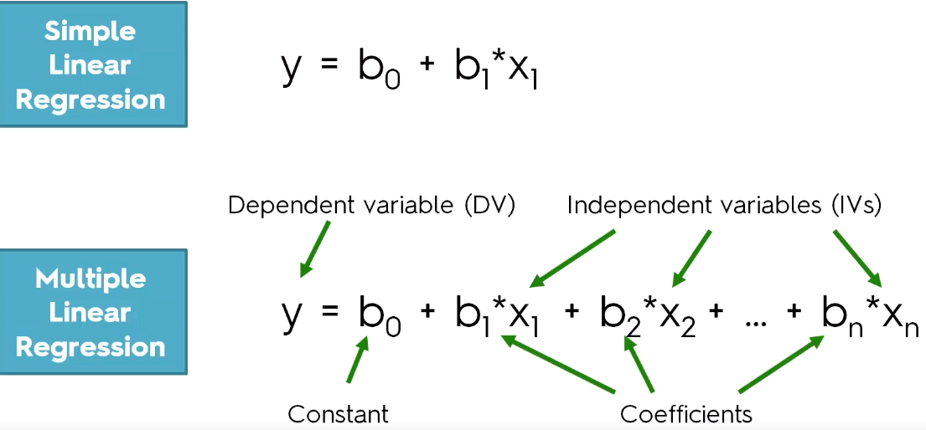
ML: Multiple Linear Regression
Linear relationship between a single dependent continuous variable and more than one independent variables
All variables are quantitative
Notes:
A linear regression model is an appropriate choice for making numerical predictions, especially when there is linear relation between the features. In our case, since we have multiple features in our dataset, a multiple linear regression model is applicable.

Slide 11
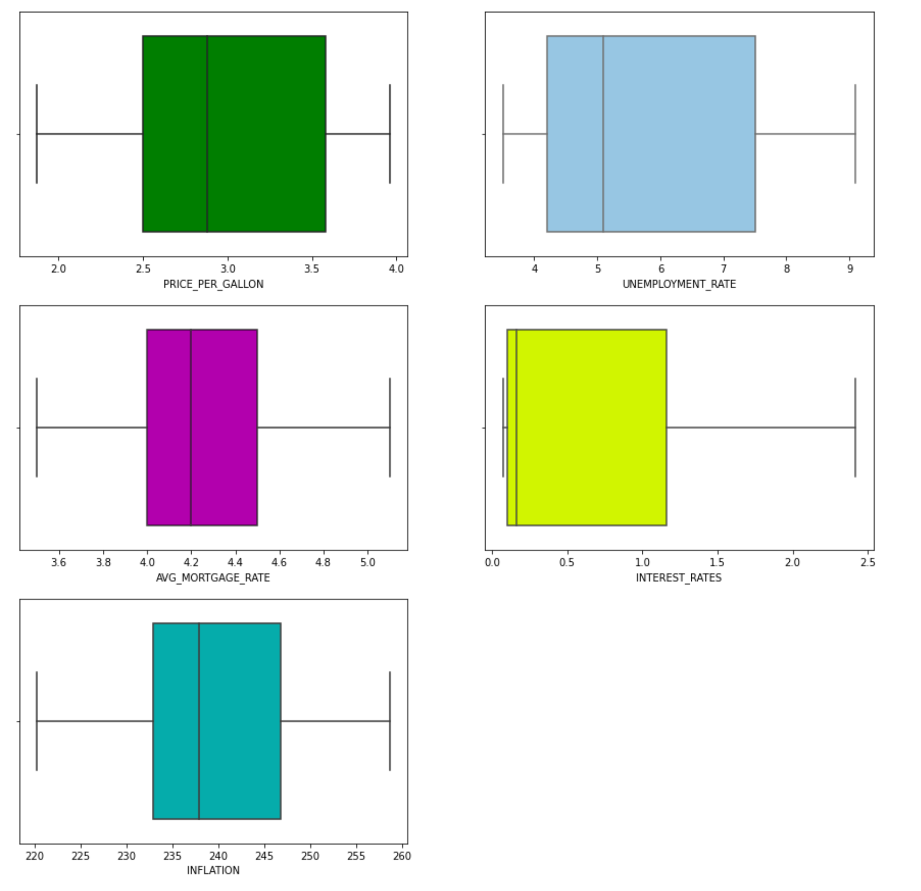
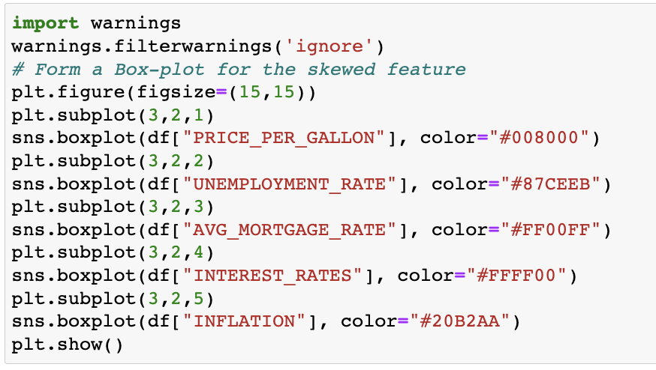
Multiple Linear Regression
Outlier Detection
Boxplot illustrated that there were no outliers in the datasets
Notes:
Presence of outliers in a dataset can result in a poor model performance. So we utilized boxplots to identify any outliers in our dataset.
As illustrated in this image, we did not find any outliers in our dataset.

Slide 12
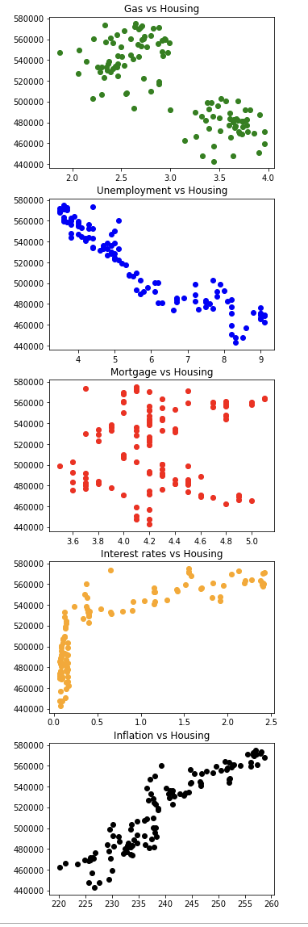
ML: Multiple Linear Regression Feature Engineering and Selection
Feature Engineering –
Finding missing values and removing from dataset
Replacing Region IDs with Zip codes
Feature Selection-
Preparing scatter plots to check linearity
Dropped Mortgage Rates
Notes:
Our Feature engineering involved handling missing values and Replacing region IDs with Zip codes as discussed during the data transformation part of our presentation.
For Feature selection: We created scatter plots for each feature. Based on the these scatter plots, we found all feature variables have a linear relationship with Housing Prices, except for mortgage rates.
So we decided to drop Mortgage Rates feature from our dataset.

Slide 13
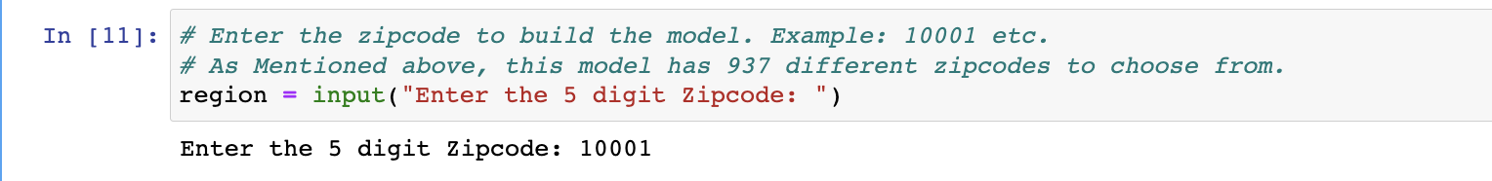
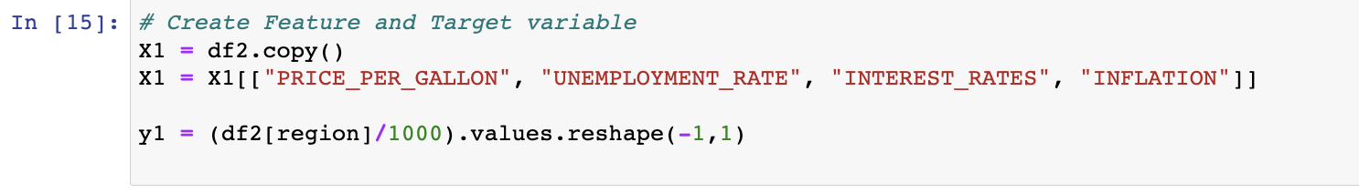
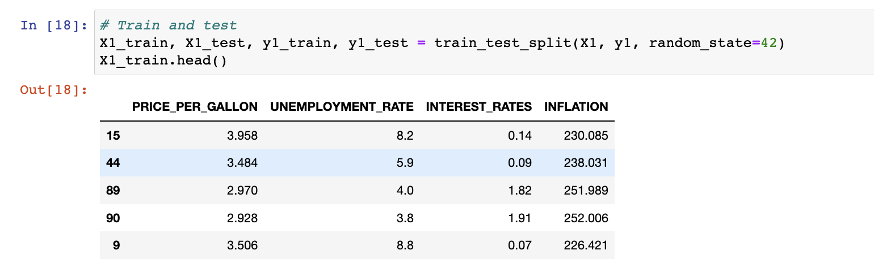
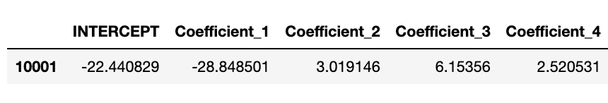
ML: Multiple Linear Regression Modeling Process
Select Zip Code
Create Feature & Target Variables
Split into Training and Testing Sets
Linear Regression Model
Model Training
Prediction
Notes:
This slide here has a quick overview of the modeling process. Notice the intercept & coefficients.

Slide 14
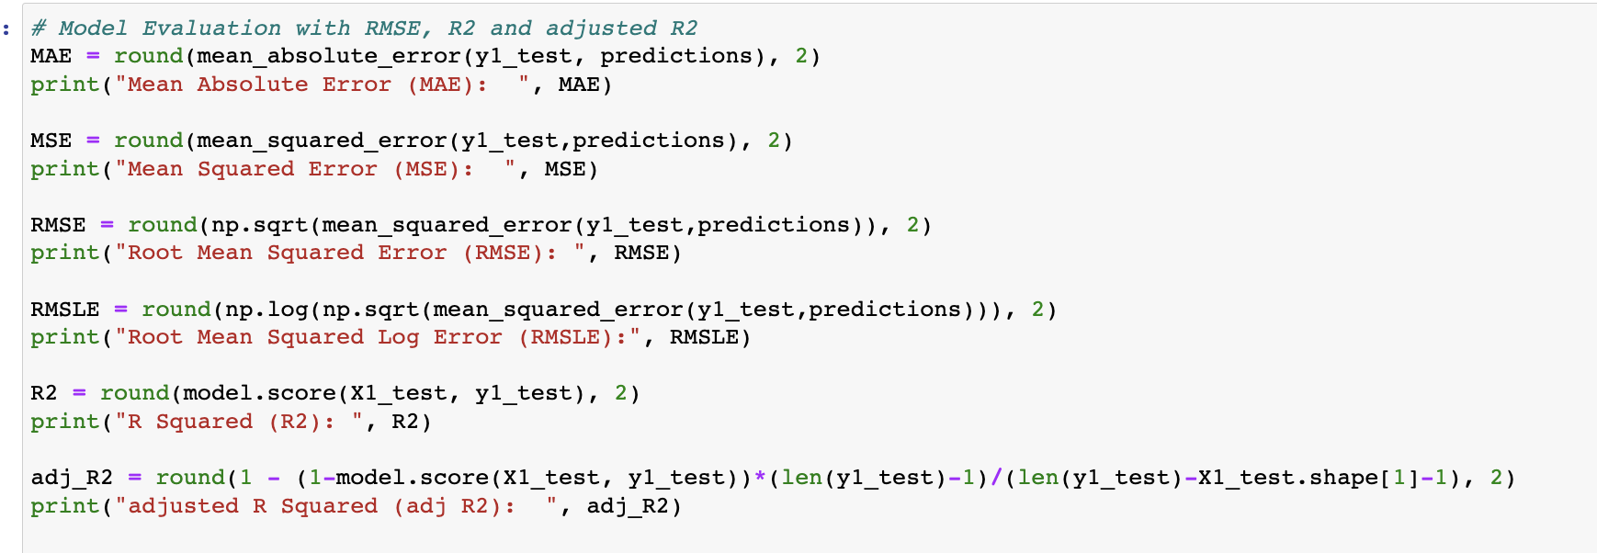
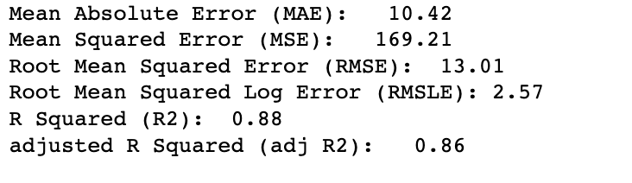
ML: Multiple Linear Regression Model Evaluation
Mean Absolute Error (MAE)
Mean Squared Error (MSE)
Root Mean Squared Error (RMSE)
Root Mean Squared Log Error (RMSLE)
R Squared (R2)
Adjusted R Squared (Adj R2)
Notes:
To evaluate model performance we calculate several parameters.
R2 is the Coefficient of Determination or Goodness of fit.
Since we have multiple features in our dataset, we also want to calculate adjusted R2.
As we can see in this example that adjusted R2 is slightly lower than R2.
----------------------------------------------
MAE is a very simple metric which calculates the absolute difference between actual and predicted values.
MSE represents the squared distance between actual and predicted values. we perform squared to avoid the cancellation of negative terms and it is the benefit of MSE
RMSE The metric is very helpful when you are developing a model without calling the inputs. In that case, the output will vary on a large scale.
To control this situation of RMSE we take the log of calculated RMSE error

Slide 15
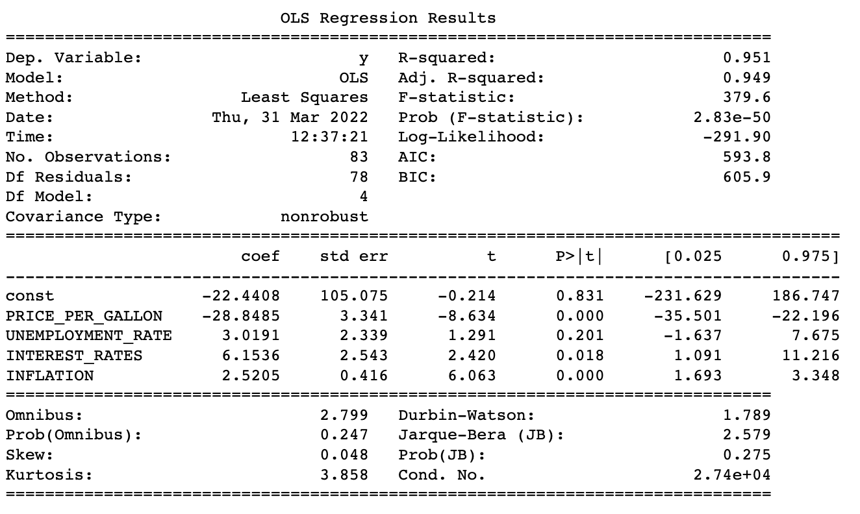
ML: Multiple Linear Regression Model Evaluation
Using statsmodel Python library (OLS function)
Notes:
Statsmodels is a Python library built specifically for statistics. We wanted to have all model statistics in one place in tabular format so we used OLS from statsmodel. (OLS) stands for Ordinary Least Squares regression
Notice that the coefficients captured in this table match with the coefficients generated by sci-kitlearn (shown in the modeling process slide).

Slide 16
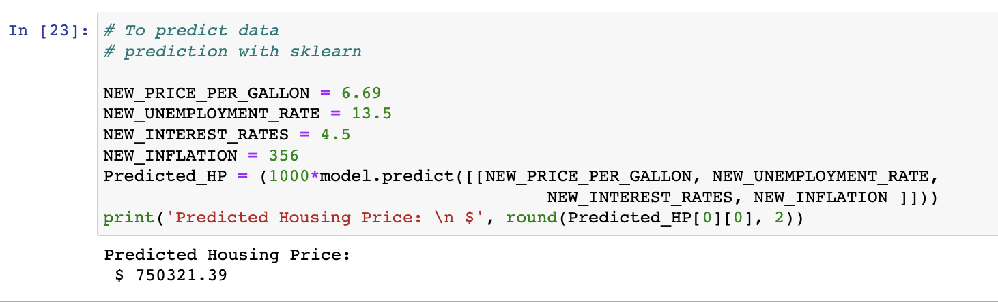
ML: Multiple Linear Regression Model Evaluation
Providing desired inputs for features and predicting housing prices in zip code 10001
Notes:
Now lets say my question is, what would be the housing price in zip code 10001 (which is in NY btw) when average gas price hits $6.69, unemployment rate hits 13.5, interest rates are at 4.5, and the Consumer price index is at 356 points. I can use this model which will predict the housing price to be at $750,321

Slide 17
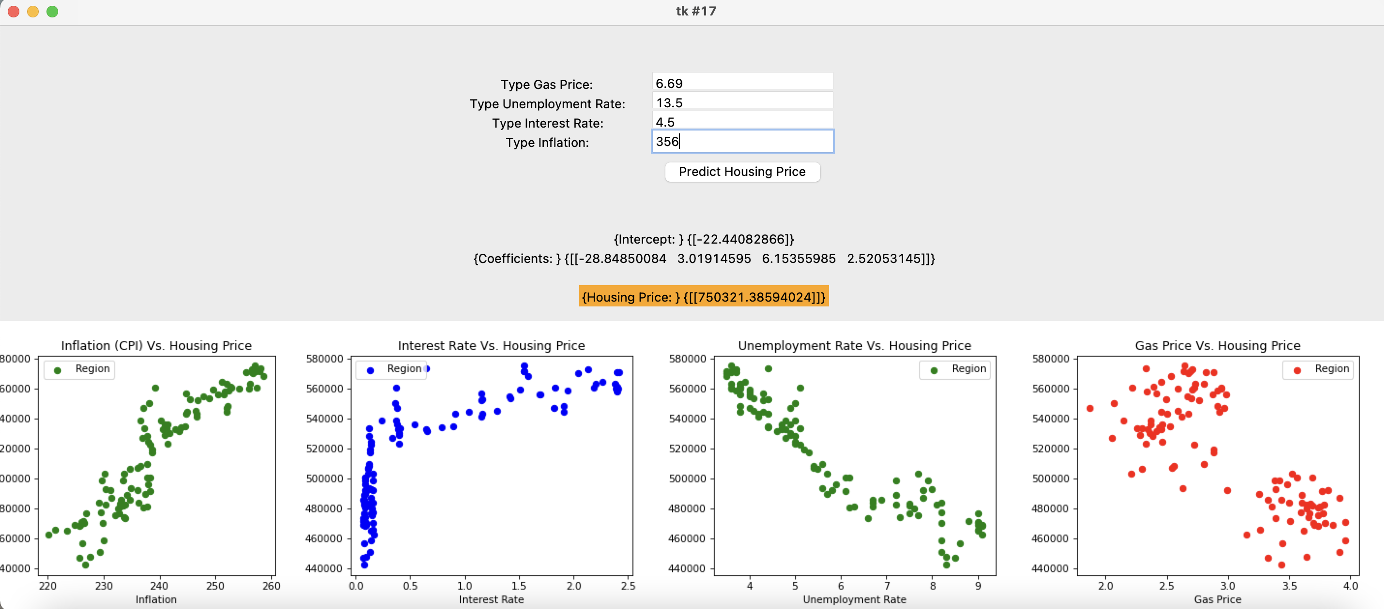
ML: Multiple Linear Regression Graphical User Interface (GUI)
GUI to allow user to input
Tkinter Python library
Notes:
We also created a Graphical User Interface to visualize the model predictions in a pop up window. This GUI will allow users to input the desired economic factors in order to get predicted housing prices.
We did this by using Tkinter, which is a standard GUI library for Python.
Once we run the code, we will see this GUI, which includes the output generated by sklearn and the scatter diagrams for the selected Zip code. To bring to your attention that this is the same prediction we saw in the previous slide by using model.predict command.
The live version of this GUI will be presented later during the dashboards and visualization section of this presentation.

Slide 18
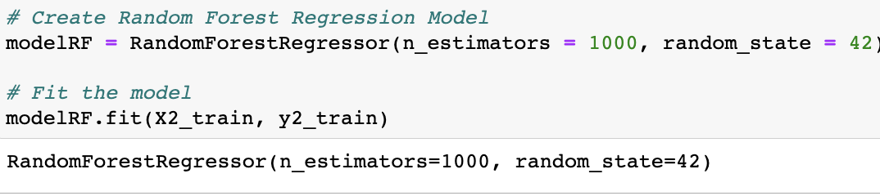
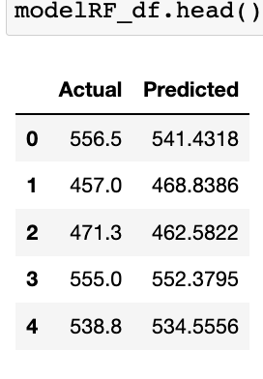
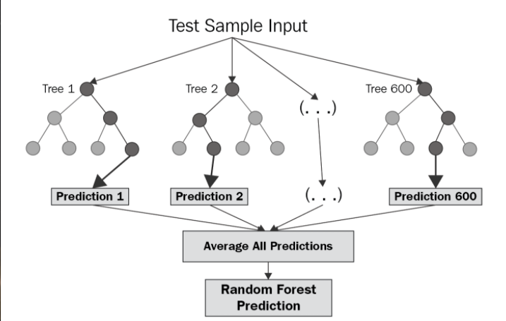
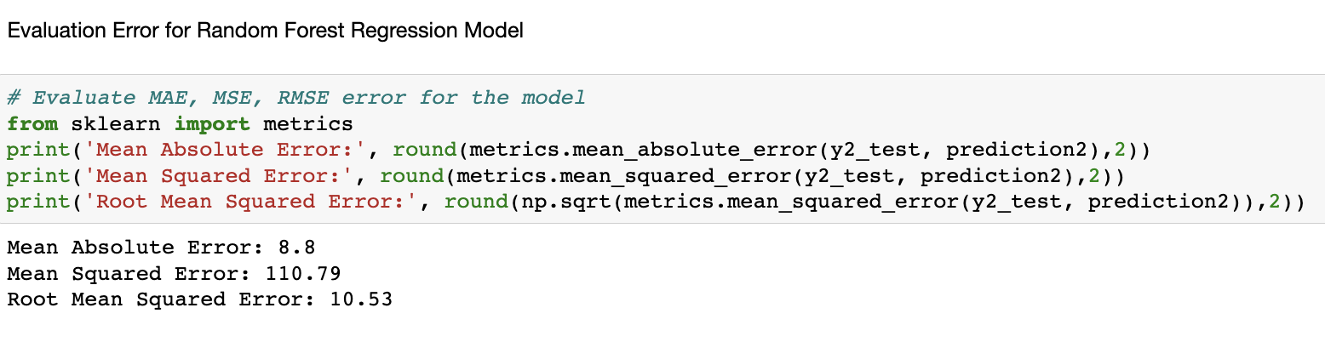
ML: Random Forest Regressor
Notes:
Now we would like to talk a little bit about the other machine learning models we considered to solve our problem of housing price prediction.
Random forest is a type of supervised learning algorithm that uses ensemble methods (bagging) to solve both regression and classification problems. The algorithm operates by building a several decision trees during training and produce the mean or mode of prediction of the individual trees.
When we apply RandomForest Regressor model with a thousand estimators and train the model, the trained model shows a comparison of actual and predicted values, which are quite close as you can see. Then we also ran model evaluation to give us model performance metrics.

Slide 19
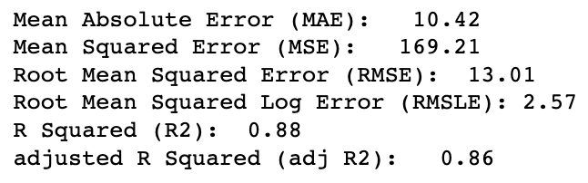
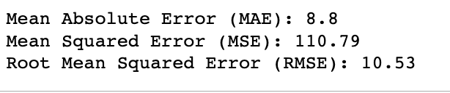
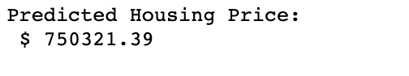
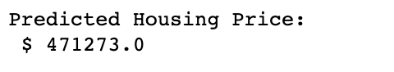
ML: Comparison– Multiple Linear Regression Vs. Random Forest Regression
Multiple Linear Regression | Random Forest
Evaluation Metrics:
Predictions with similar inputs:
Random Forest is Better?
Why we can’t use this model?
Decision trees, less chance of overfitting
Greater Accuracy
Cannot Extrapolate
Notes:
We have comparison of the Multiple linear regression model and Random Forest Regressor. When we compare the evaluation metrics of the two models, shows that the Random Forest performs better. But when we want to predict with the same input parameters, we see that the predictions are very different! It is because random forest regressor can not extrapolate and will always make predictions less than the maximum value of the datasets that has been trained.
So, to summarize, a random forest model is better because decision trees have less chance of overfitting and can provide greater accuracy.
We canno’t use this model for this specific problem because it cannot extrapolate.

Slide 20
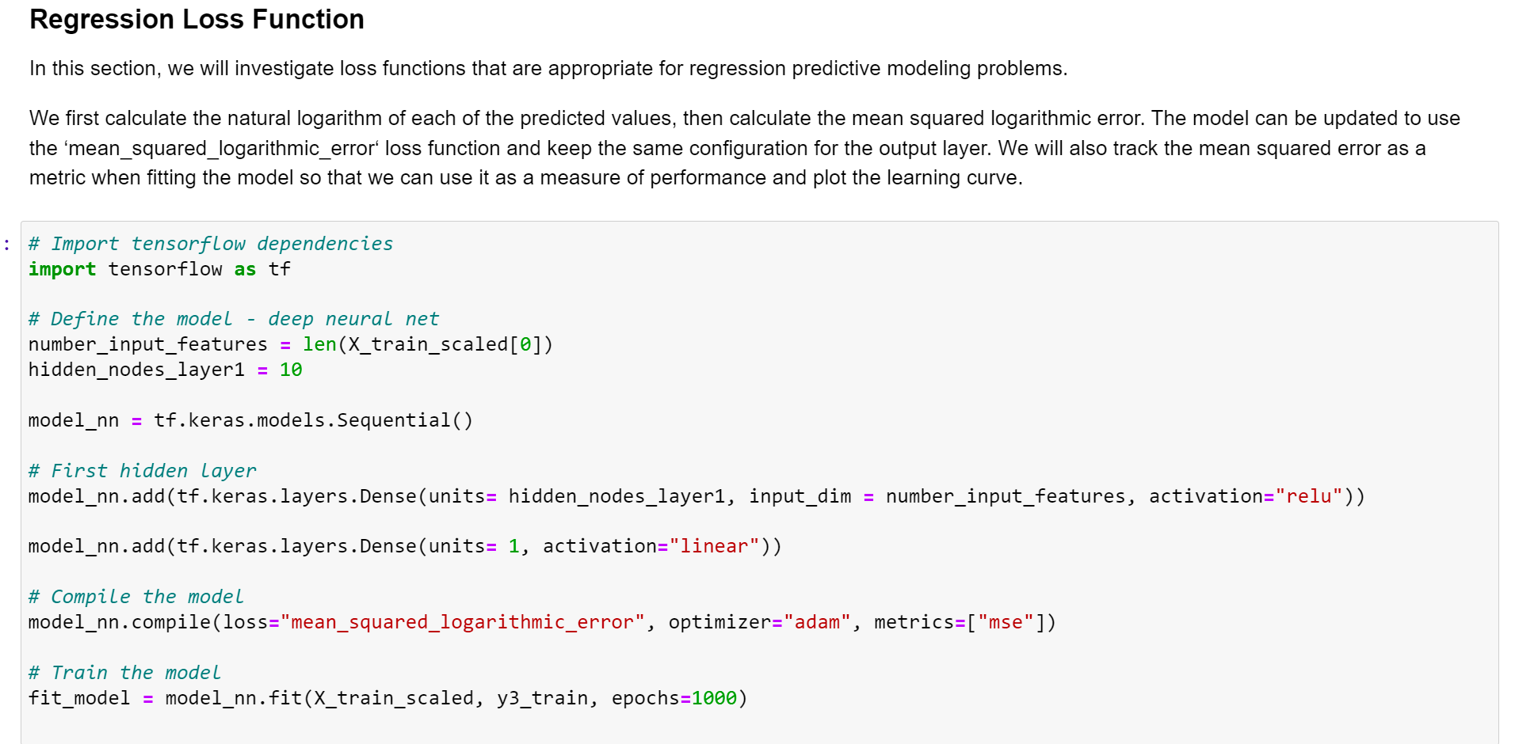
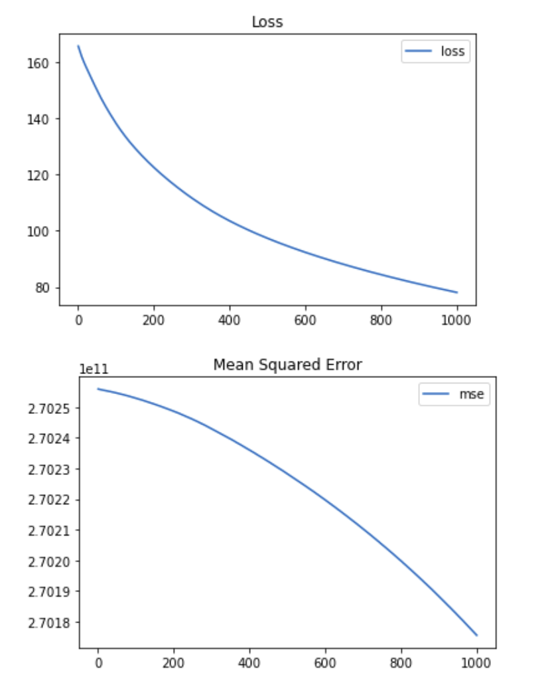
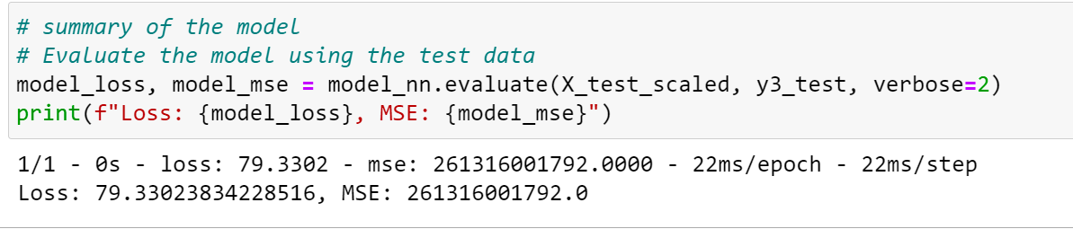
ML: Neural Network Model
Notes:
We are using the linear function in the output to determine MSE (Mean squared error) instead of Accuracy for the Evaluation metrics. We started with lower Epochs number (~50) . In order to improve the model design and parameters, we increased the number of epochs up to 1000. Seems like loss values decreases with higher Epochs number as you can see in the plot on the right side. For this study, we stop at 1000 epochs. This model still doesn’t meet the performance expectations. It can be because our given datasets are Inappropriate for this model design or insufficient training data. (Having more datasets would be beneficial).

Slide 21
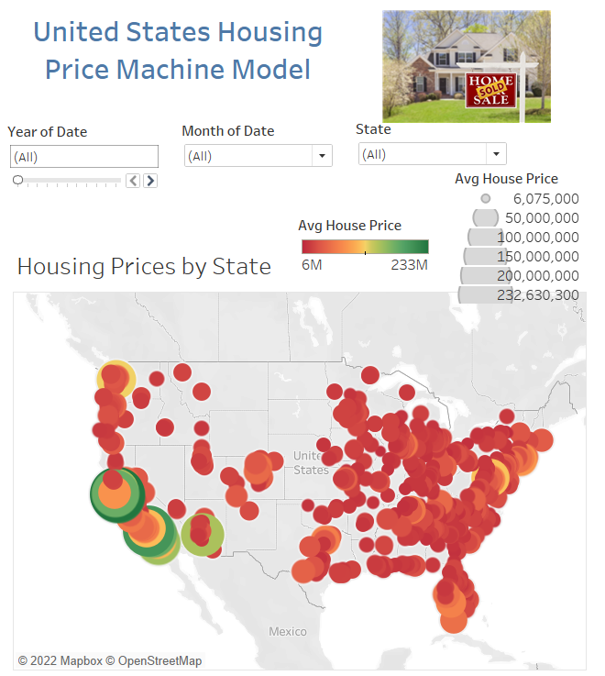
Data Visualization: GUI & Tableau
Outlier Project | tkinter GUI | Tableau Public

Slide 22
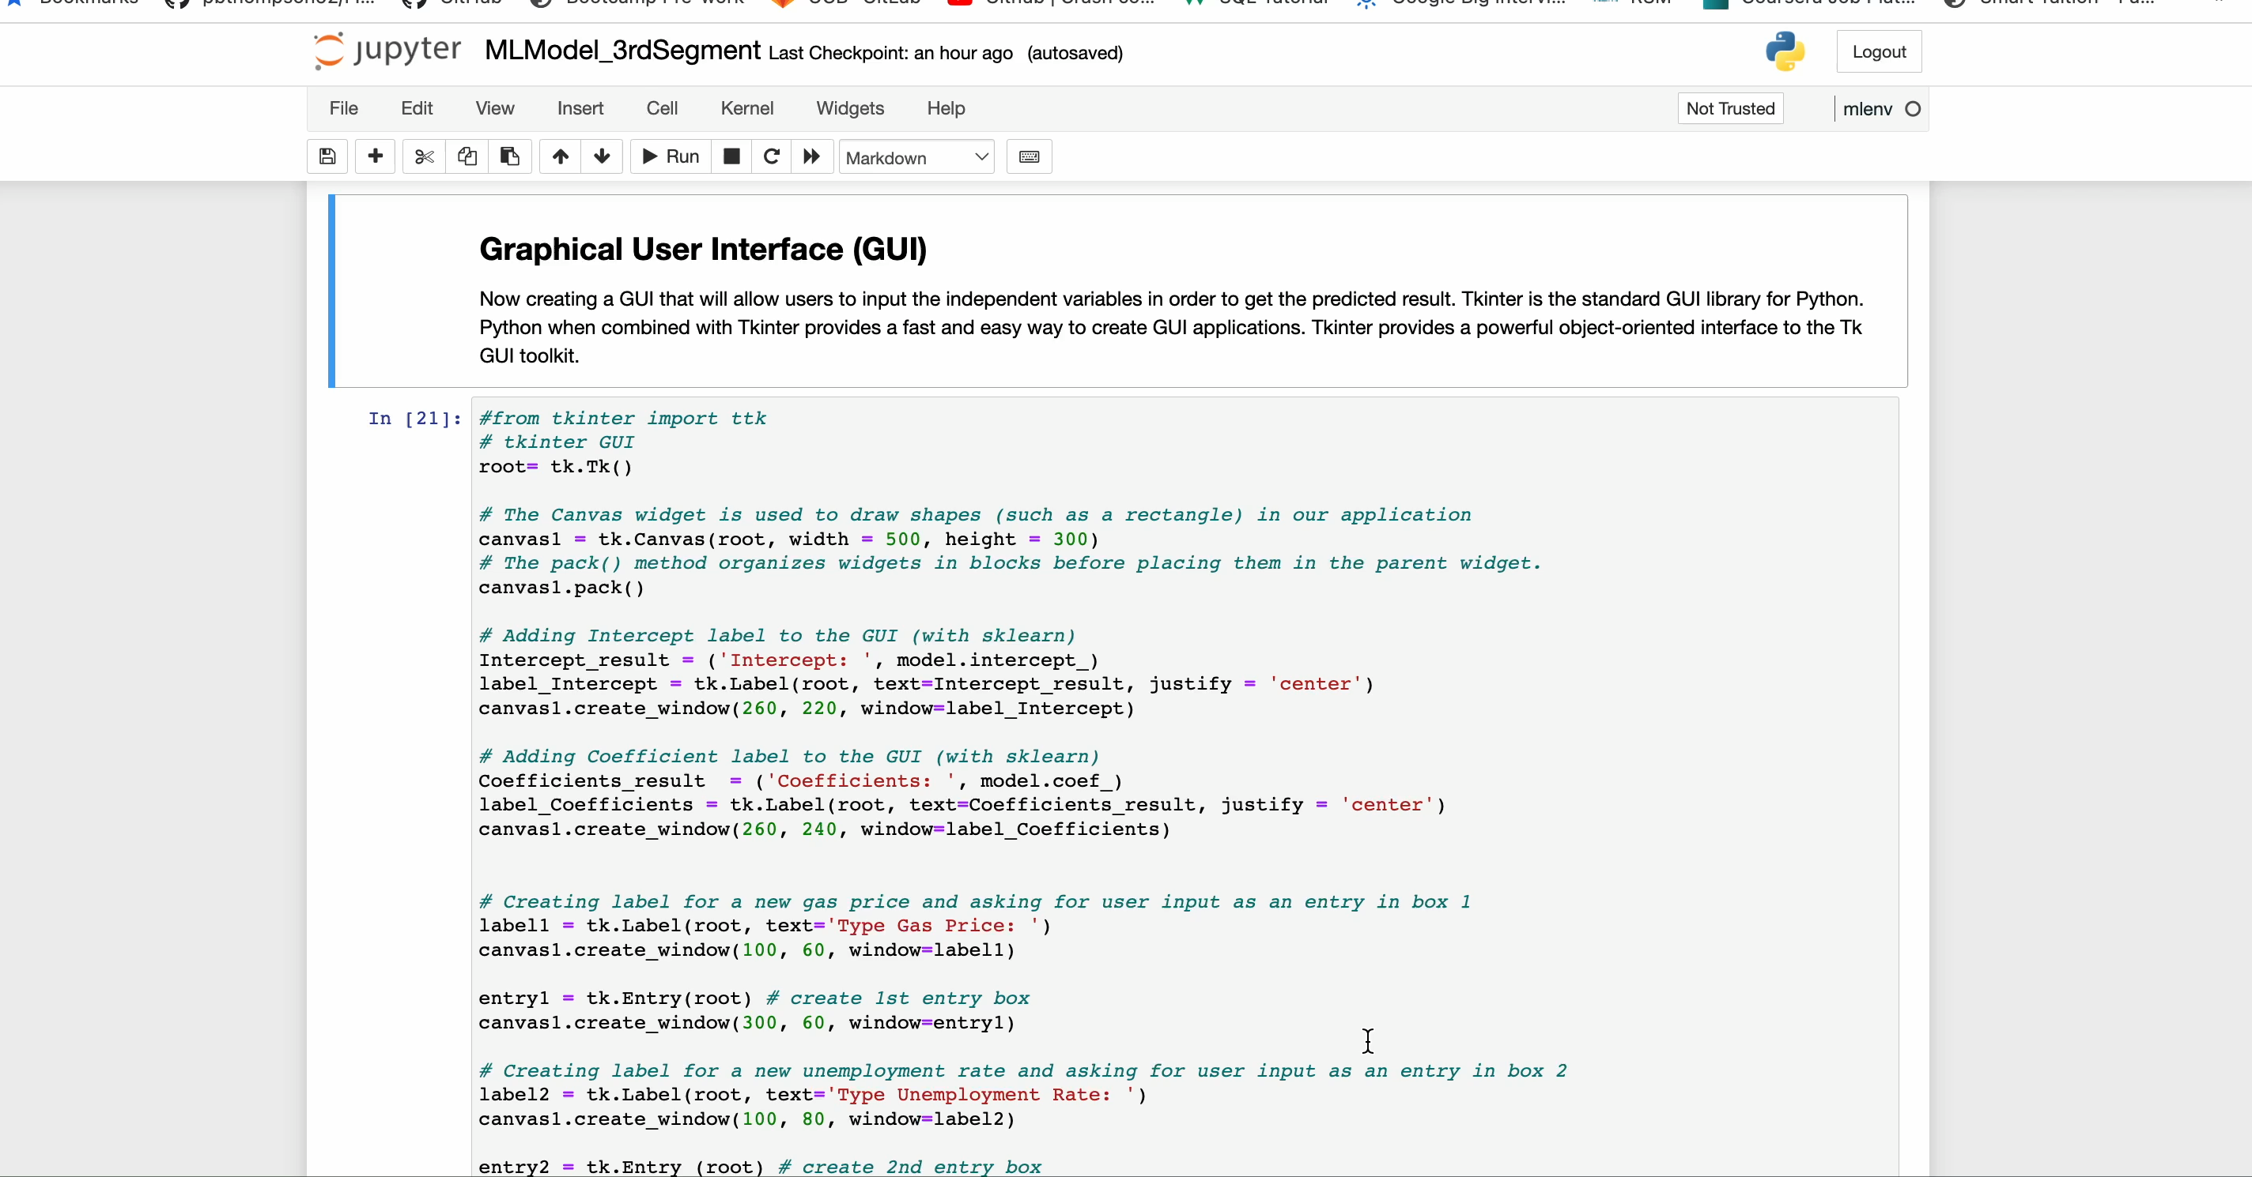
Multiple Linear Regression Model: Graphic User Interface
Notes:
This is a visualization of the multiple linear regression model using the GUI tkinter python library.
When we run this code, it brings us to a pop up window asking for user input values. We will input the exact same values as we did before for predictions. Upon entering all the numbers, we click the ‘Predict Housing Price Button’ and we get a prediction highlighted in orange. This number $750,321 is the same what we got before with the sklearn model.

Slide 23
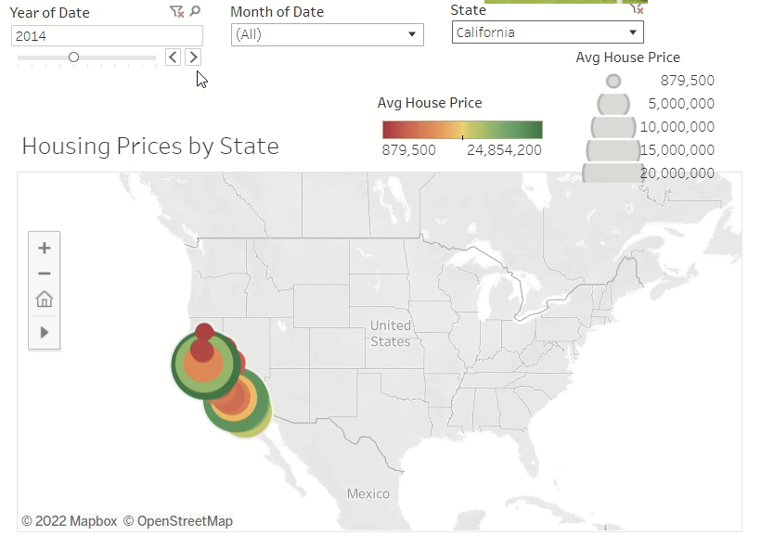

Slide 24
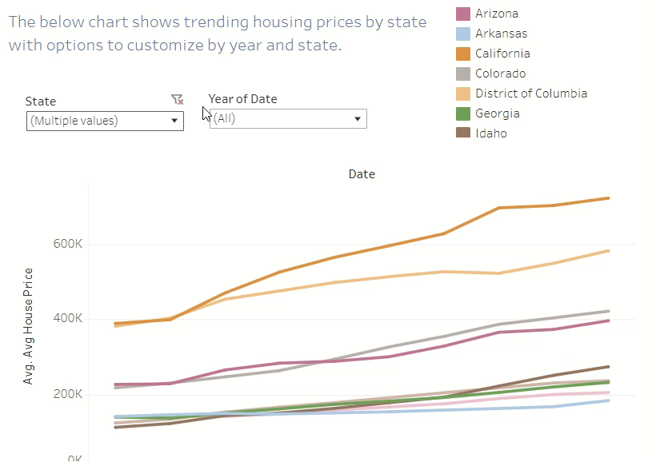

Slide 25
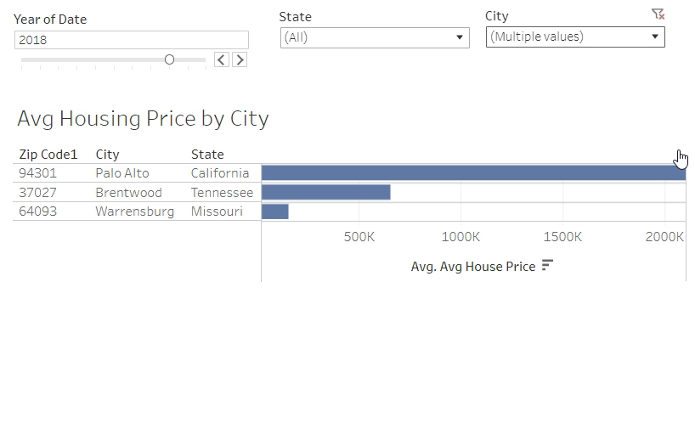

Slide 26
Recommendations and Lessons Learned
Recommendations
Research more region-specific data points
Lessons Learned
Add additional variables
Identify more region-specific variables
Identify more comprehensive data source to eliminate null values

Slide 27
Questions?

Slide 28
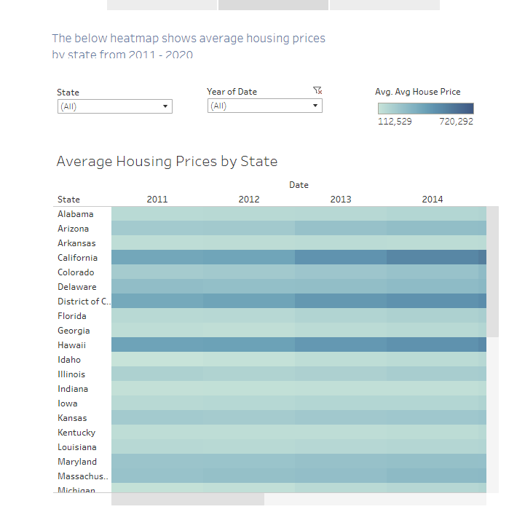

Slide 29
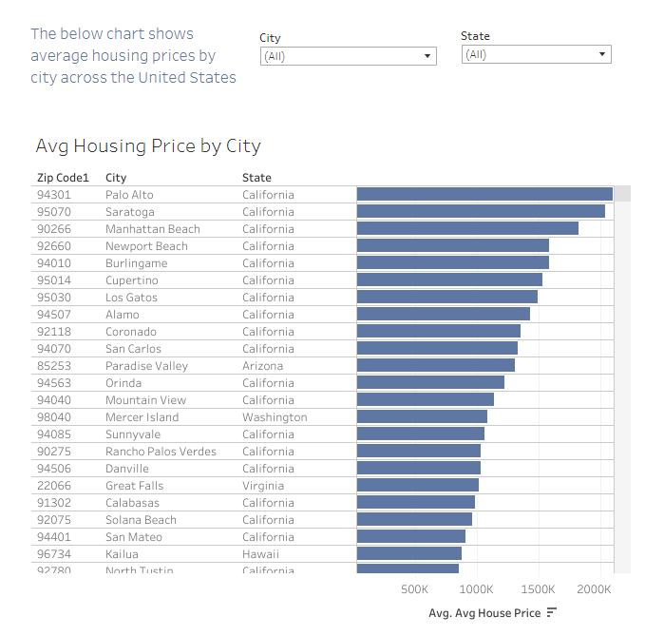

Slide 30
Appendix

Slide 31
Project Flow Chart
Datasets (CSVs, Labeled):
Consumer Price Index
Housing Prices
Mortgage Rates
Gas Prices
Unemployment Rates
Data Transformation:
Dropping null values
Filtering dates
Dropped unnecessary columns
Transposed data
Set date as index, region id as column headers
Converted date to uniform date-time
Assigned zips and coordinates to locations
Database:
Postgres
Compiled CSV
Machine Learning Model:
Multiple Linear Regression Model
Ran
Model Evaluation:
Adjusted R2
Notes:
Here you can see ahigh level summary of the various stages of our project
We are going to be covering each of these stages in more detail during our presentation

Slide 32
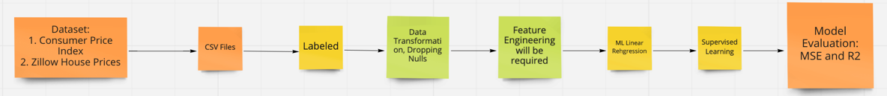
Machine Learning Flow Chart
Datasets (CSVs, Labeled):
Consumer Price Index
Housing Prices
Mortgage Rates
Gas Prices
Unemployment Rates
Data Transformation:
Dropping null values
Filtering dates
Dropped unnecessary columns
Transposed data
Set date as index, region id as column headers
Converted date to uniform date-time
Assigned zips and coordinates to locations
Machine Learning Model:
Multi-Linear Model
Supervised Learning
Model Evaluation:
MSE
R2

Slide 33
Icons Icons should be primarily used as a visual aid, as a way to break up large amounts of text and content, or as a visual cue of the content that follows. Get the full set of icons for presentations
INDUSTRY SECTORS
Aeronautics | Agriculture | Architecture | Automotive | Construction | Education and research | Energy | Financial services | Healthcare | Engineering and manufacturing | Professional services, media | Sports
Government | Retail | Technology | Media and broadcasting | Travel and transportation | Education | Law | Science | - | - | - | -
MAPS / LOCATION
Globe, global, earth | Globe, global, earth | Navigation, GPS, POI, location, map | Map, location, GPS, directions, navigation | Navigation, GPS, POI, location, map | Map, location, route, quest, destination, journey | Download map, receive location | - | - | - | - | -
MONEY / FINANACE / RETAIL / CONSUMER
Shopping cart, store | Store, bag, shop | Money, dollar sign, cash, revenue, currency | Revenue, financial report, funds | Money, currency, coins | Bank, piggybank | Compare, balance, finance, justice | Credit card, payment, charge, debit card | Mobile payment, digital payment, e-commerce | Barcode scanner | Tag, sale, shopping | Bank

Slide 34
Get the full set of icons for presentations
OBJECTS / TOOLS
Alarm clock | Hourglass, timer | Clock | Flashlight | Funnel | Calculator | Binoculars | Scissors | Camera | Battery, power, charge | Magnifying glass | Tools, screwdriver, wrench
Paperclip | Pushpin, thumbtack | Key | Lock | Safe | Piggybank | Bag | Ballot box, drop box | Box, archive, storage | Present, giftbox | Box, package, shipping | Briefcase, business, work, job
Books, reading | Book, dictionary, novel | Notebook, journal | Pencil | Paintbrush | Paint palette, color | 3D, hologram | Trophy, award | Ribbon, award, reward, accomplishment | Ribbon, award, reward, accomplishment | Flag, finish line | Flags, finish line, win, race
Open door, entryway, opportunity | Clipboard | Megaphone, speaker, speech, announcement | Microphone | CD, music album | Headphones | Headset | Eye glasses | Bike, bicycle | Umbrella, bumbershoot | Balloon, party, celebration | Rocking chair
Remote control | Robotic, manufacturing, mechanical, automation | Forklift | Gears | Traffic cone, construction | Flask, chemistry, science, beaker | Maze, puzzle | Target, bullseye, aim, arrow, dartboard, darts, archery | Games, strategy, chess, poker | Musical instrument, drums | Pizza, food | Lightbulb

